Slide 1

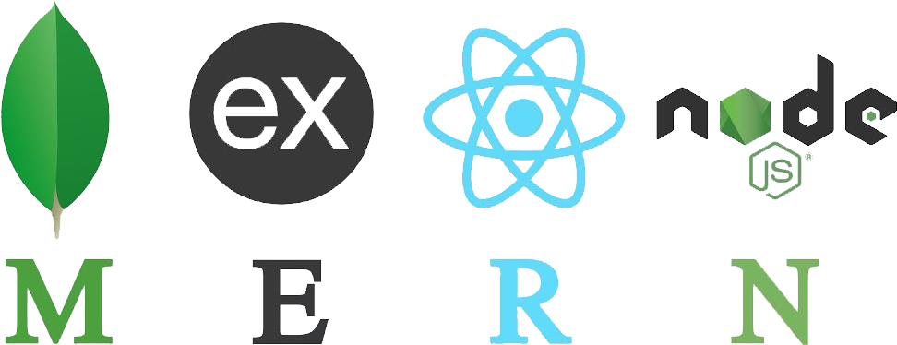




MERN STACK SUMMER INTERSHIP
Name – ARJYAMAN DAS
SIC No- 20BECC85
DEPT- ECE
Instructor-Mr. Anupam Roy

Slide 2
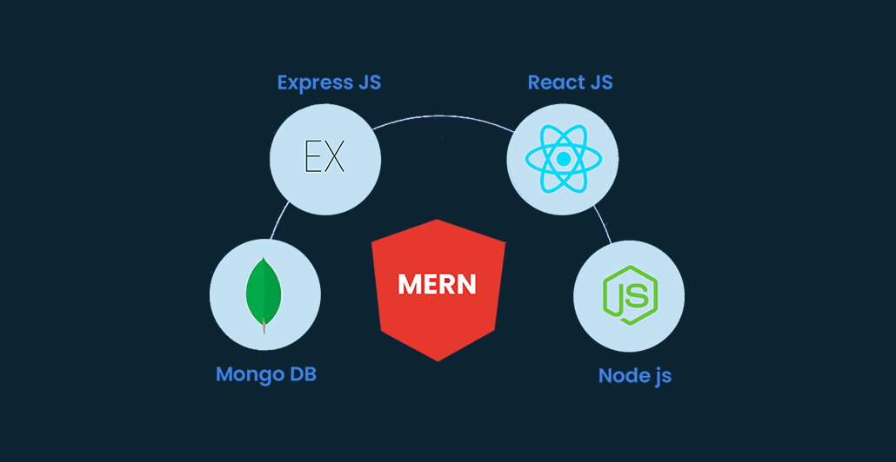
CONTENTS…
Introduction
Objective
Methodology used
Result Analysis
Conclusions

Slide 3
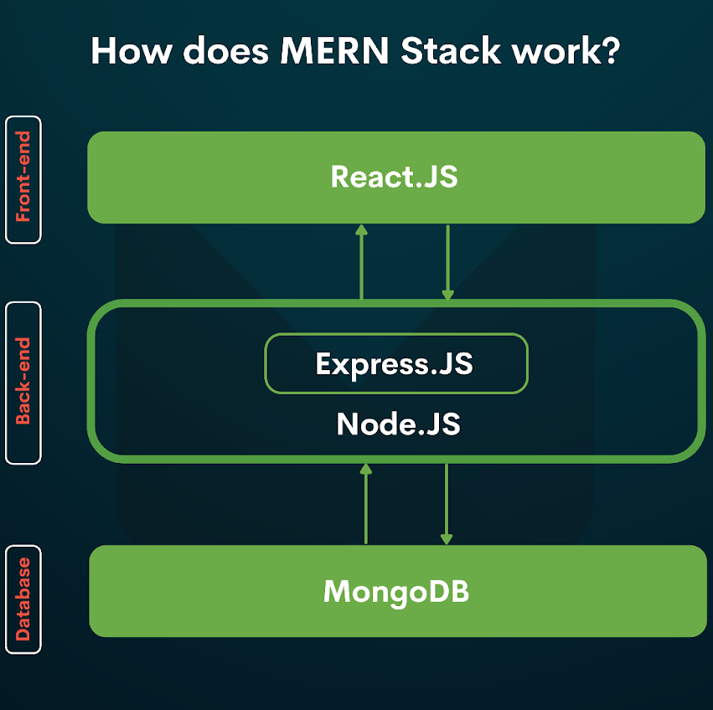
INTRODUCTION…
MERN stands for MongoDB, Express.js, React, and Node.js, after the four key technologies that make up the stack that is used for easier and faster deployment of full stack web applications.
MongoDB- Document Database
Express(.js)- Node.js Framework
React(.js)- A client-side JavaScript Library
Node(.js)- JavaScript Runtime environment

Slide 4
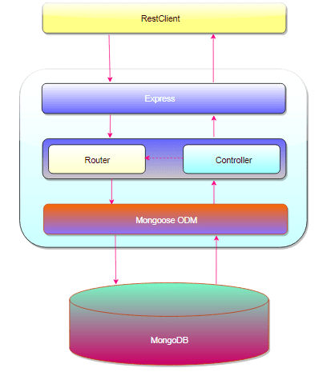
Objective
Through this MERN stack architecture we will construct a 3-tier architecture (Frontend, Backend, Database) entirely using JavaScript.

Slide 5
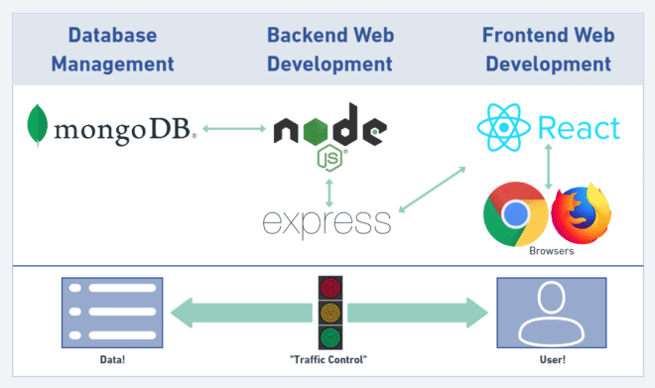
METHODOLOGY USED…
Methods used in MERN stack development are as follows :
MongoDB
ExpressJS
ReactJS
NodeJS

Slide 6

6
MongODB
No SQL database used for high-volume data storage.
Open-Source document-oriented database.
MongoDB is written in C++.
It stores data in JSON format.
MongoDB uses BSON to query database.

Slide 7
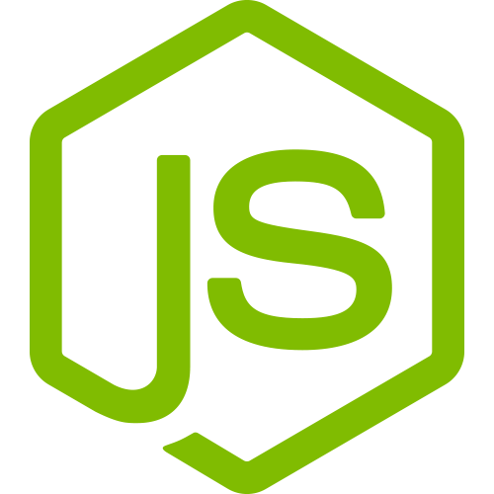
7
Express.js
Flexible Node.js framework that provides robust set of features for web and mobile application.
It provides easy routing of requests based on HTTP methods and URLs.
It allows to set up middleware's to respond to HTTP Requests.
Allows to dynamically render HTML pages based on passing arguments to templates.

Slide 8
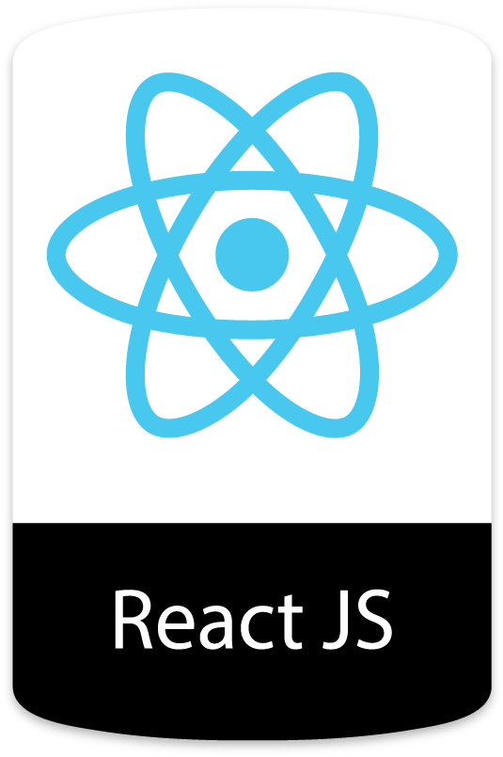
8
React
A JavaScript library for building user interfaces for web and mobile applications.
React is used to build single-page applications.
React allows us to create reusable UI components.
React-router to handle the front-end routing.

Slide 9
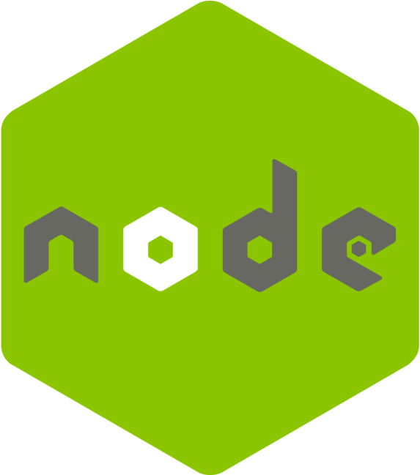
9
Node.js
A JavaScript run-time environment.
Node.js allows you to run JavaScript on the server.
It’s free & open source, written in C++.
Node.js runs single threaded, non-blocking, asynchronous programming.

Slide 10
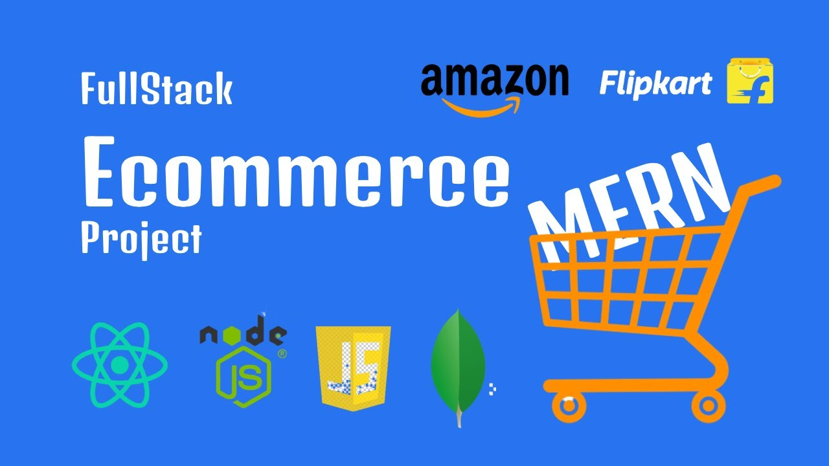
Work done during the internship
Title of the major project: e-Commerce Website
In this project we made a shopping website in which there is a signup and login page where the user and administrator can login or signup.
We also implemented add to cart option and add product delete product from administrator side and many more.

Slide 11
RESULT ANALYSIS…
Buying items and offerings via E-commerce allows purchasers the liberty to pick whilst and where to save and the possibility to analyze the product, the vendor, and another to be had alternatives. shopping has been revolutionized through the availability of online statistics. just about something that can be sold in products shops can be offered thru E-trade, even perishables like groceries. And clients have embraced these opportunities around the globe. It may also reduce costs in managing orders and interacting with a extensive range of providers and trading companions, areas that normally add giant overheads to the price of services and products. For growing countries like India, e-commerce gives significant opportunity.

Slide 12

CONCLUSION…
The achievement of the thesis is researching the basic components of MERN stack technology: MongoDB, ExpressJS framework, ReactJS library and NodeJS platform. Using MERN stack technology in conjunction with Braintree to build an e-commerce web application with payment gateway. Since the purpose of the thesis is the e-commerce application, the understanding about MERN technologies and applying it to this app is the most important. Overcome current shortcomings, listen to customers’ comments and making improvements, helping users have a great experience in the future.

Slide 13
13
Thank you

